Slide 1


Single Photon Microscopy
Only including section generated by Avery Books
This was made for EE218A @ UC Berkeley
with Prof. Kante
Speaker Notes: Notion

Slide 2
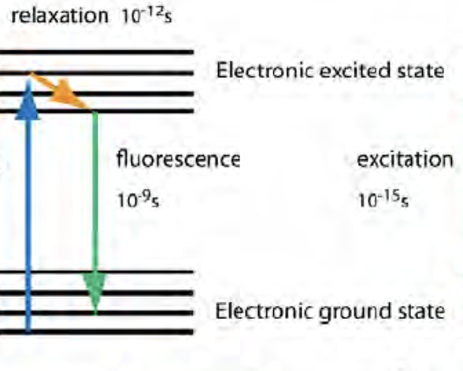
How Single Photon Microscopy Works
What is Single Photon Microscopy?
Uses an external light source to pump specimen that is embedded with single-photon emitters that absorb a photon from the pump, excite and de-excite it’s electron, and emit single photons which are detected by the microscope array.
  Single Photon Sources - Quantum Dots, Organic Dyes, Fluorescent Proteins
  Engineering of single photon sources
  Applications of single photon
  Brief comparison to another method
Source: [14]
‹#›
Notes:
Avery

Slide 3
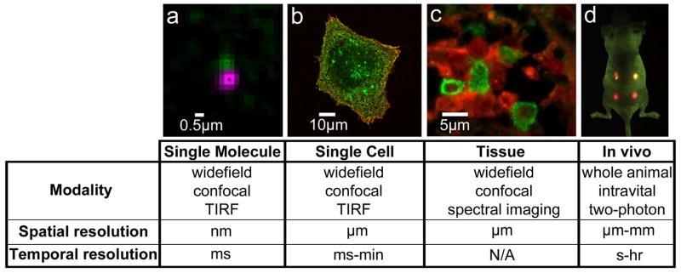
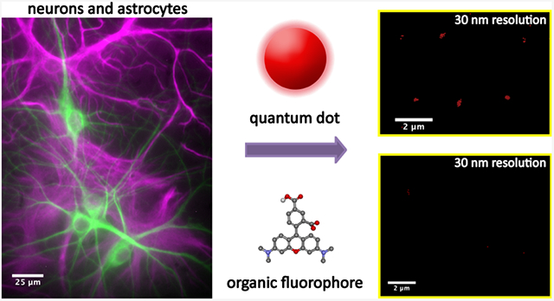
Single Photon Sources: Why Important?
Break resolution limit by isolation of PSFs
Sources integrated into object
[1] Urban, J. M., et. al. (2021). Quantum Dots for Improved Single-Molecule Localization Microscopy.
[2] Vu, T. Q., et al. (2015). Quantum dots for quantitative imaging: from single molecules to tissue.
Notes:
a) Single molecule detection provides high spatiotemporal resolution. Example of two-color QD tracking of QD-labeled EGF bound to EGFR (see also Low-Nam et al, 2011). b) Live cell imaging captures dynamics of cellular processes. Image shows QD-EGF (red) binding to EGFR (green) on the surface of an A431 cell (see also Lidke et al, 2004). c) QDs used in immunohistochemistry (IHC) assays allow for multiplex imaging. Example of two-color QD-IHC in human spleen tissue with QD-labeled antibodies against mast cell tryptase (green) and c-Kit (red) (image by E.W. Hatch, Lidke Lab). d) QDs can be visualized in in vivo imaging. Image shows simultaneous in vivo imaging of spectrally distinct QD-encoded microbeads. Image courtesy of X. Gao (see also Gao et al, 2004).

Slide 4
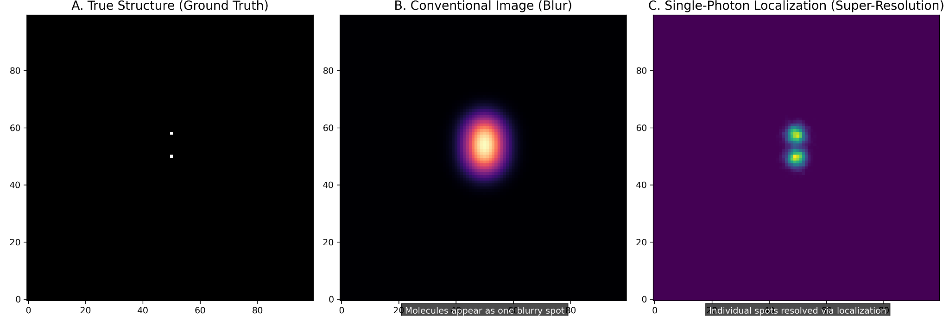
Python Simulation - Comparison with Std. Microscopy
‹#›

Slide 5
Single Photon Sources: Types
Quantum Dots (QDs)
0-dimensional nanoscale semiconductor crystal that “blinks” and behaves as an artificial atom
Made via “wet chemistry”
0-dimensional
“Blinking”
Electrons spatially constricted s.t. 0 d.o.f.
Forces electron to discrete energy levels
Inherent stochastic binary states of fluorescence
Sparse random subset of probes in the dot are “on” at any given point and are required to locally isolate
‹#›
Notes:
Explain stochastic

Slide 6
Single Photon Sources: Types
Organic Dyes
Small Molecule dyes that are conjugated to antibodies or other agents that blink due to chemical buffers
Chemical Buffers
Optical properties
Requires optimized and cytotoxic imaging buffers to induce blinking
Less photo stable and less total photons than QDs before photobleaching
Small size minimizes linkage errors -> better map of location
‹#›
Notes:
Explain stochastic

Slide 7
Single Photon Sources: Types
Fluorescent Proteins
Genetically encoded labels that are produced by cell
Photoactivatable
Photoconvertible
Properties
Exist in “off” state and turn “on” when excited (irreversible)
Change emission color after activation by particular wavelength
Endogenous and biocompatible
Low photon count and photostability
‹#›
Notes:
Explain stochastic

Slide 8
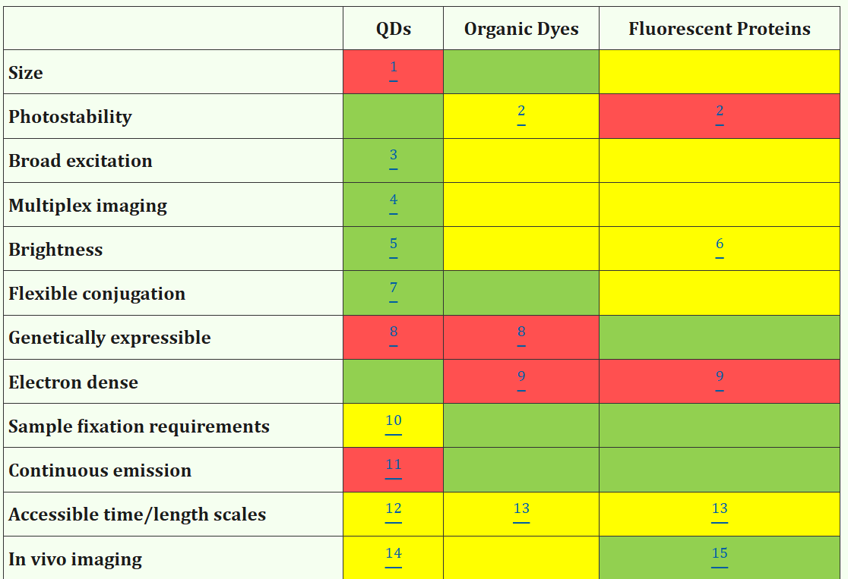
Fig from:
Interventions for preventing or controlling health care–associated infection among health care workers or patients within primary care facilities: A scoping review
Lucyna Gozdzielewska, PhD, et. al.
‹#›

Slide 9
Spontaneous Emission
Quantum Mechanics & Electrodynamics govern the emission parameters:
Dirac Theory of Radiation
Fluorescence Parameters
Transition of states is viewed as interaction with vacuum fluctuations of QEM field (random phase)
Molar Extinction Coefficient (probability to absorb)
Fluorescence Quantum Yield (brightness)
Fluorescence Lifetime (avg. time in excited state)
‹#›
Notes:
Avery

Slide 10
Comparison to Differential Interference Contrast (DIC) Microscopy
Single Photon:
Incoherent Fluorescence
Chemical Map: shows precise location of specific labeled molecules
Intensity
Limited by Diffraction (not as much)
Differential Interference Contrast
Phase shifts cause by sample’s refractive index
Shows surface contours and optical density
Phase converted to pseudo - 3D shadow cast images
Limited by diffraction
‹#›
Notes:
Avery

Slide 11
Sources
Urban, J. M., Chiang, W., Hammond, J. W., Cogan, N. M. B., Litzburg, A., Burke, R., Stern, H. A., Gelbard, H. A., Nilsson, B. L., & Krauss, T. D. (2021). Quantum Dots for Improved Single-Molecule Localization Microscopy. The journal of physical chemistry. B, 125(10), 2566–2576. https://doi.org/10.1021/acs.jpcb.0c11545
Vu, T. Q., Lam, W. Y., Hatch, E. W., & Lidke, D. S. (2015). Quantum dots for quantitative imaging: from single molecules to tissue. Cell and tissue research, 360(1), 71–86. https://doi.org/10.1007/s00441-014-2087-2
Betzig, E., Patterson, G. H., Sougrat, R., Lindwasser, O.W., Olenych, S., Bonifacino, J. S., Davidson, M. W., Lippincott-schwartz, J., Hess, H. F. (2006). Imaging Intracellular Fluorescent Proteins at Nanometer Resolution. Science. Imaging Intracellular Fluorescent Proteins at Nanometer Resolution
Zhong, Haining. (2010). Photoactivated Localization Microscopy (PALM): An Optical Technique for Achieving 10-nm Resolution. Cold Spring Harbor protocols. 2010. pdb.top91. 10.1101/pdb.top91.Photoactivated Localization Microscopy (PALM): An Optical Technique for Achieving 10nm Resolution
Simply Forensics. (2025). Unveiling the Microscopic World: A Comprehensive Guide to Microscopy Techniques. Simplyforensic. Microscopy Techniques: A Complete Guide to Imaging Methods
iBiology Science Stories. (2011, Jan 8). Eric Betzig and Harald Hess (Janelia Farm/HHMI): Developing PALM Microscopy https://www.youtube.com/watch?v=GcQ24khZzvU&t=558s
“History of Microscopes.” Microscope.com, Education Center, Microscope.com, www.microscope.com/education-center/articles/history-of-microscopes. Accessed 24 Nov. 2025.
Dahal, Prashant. “Microscopy: History, Classification, and Terms.” Microbe Notes, 24 Nov. 2023, microbenotes.com/microscope/.
“Microscope Optical Components Introduction.” Evident Scientific – Knowledge Hub, Evident Scientific, www.evidentscientific.com/en/microscope-resource/knowledge-hub/anatomy/components. Accessed 24 Nov. 2025.
Betzig, E., Patterson, G. H., Shroff, H., Lippincott-schwartz, J., Davidson, M. W., “Introduction to Photoactivated Localization Microscopy” Zeiss. Zeiss: Introduction to PALM
Murphy, D. B., Moulding, R. S., Spring, K. R., Schwartz, S., & Davidson, M. W. (n.d.). Introduction to Phase Contrast Microscopy. Nikon’s MicroscopyU. https://www.microscopyu.com/techniques/phase-contrast/introduction-to-phase-contrast-microscopy
Chen, N., Gao, G., Chong, S. P. (2012).“Focal Modulation Microscopy: Principle and Techniques” National University of Singapore. 10.5772/30906. Focal Modulation Microscopy
Dirac, P. A. M. (1927). The Quantum Theory of the Emission and Absorption of Radiation. Proceedings of the Royal Society of London. Series A, Containing Papers of a Mathematical and Physical Character, 114(767), 243–265

